Slide 1

Title: Analysis of Motor Vehicle Collisions in NYC
Subtitle : Insights from the Dataset
Name : Pavithra B
Date Submitted : 16.12.2024

Slide 2
Introduction:
Objective of the analysis:
Explore time-based trends.
Understand the geographic distribution of crashes.
Analyze injuries and fatalities.
Dataset details:
Source: NYC Open Data.
Rows: 1048575 ; Columns: 29.
Key fields: CRASH DATE, BOROUGH, LATITUDE, LONGITUDE, INJURIES, FATALITIES.

Slide 3
Data Cleaning:
Key Steps Taken:
Handled missing values (e.g., replaced with mean and mode or excluded rows).
Identified and managed outliers for LATITUDE and LONGITUDE.
Converted CRASH DATE to a datetime format.

Slide 4
Yearly Distribution of Crashes
Visuals:
Histogram : reveals the frequency of motor vehicle
crashes over the years.
Key Observations:
Identified years with unusually high or low crash counts.
Trends suggest potential external influences like policy changes or seasonal factors.

Slide 5
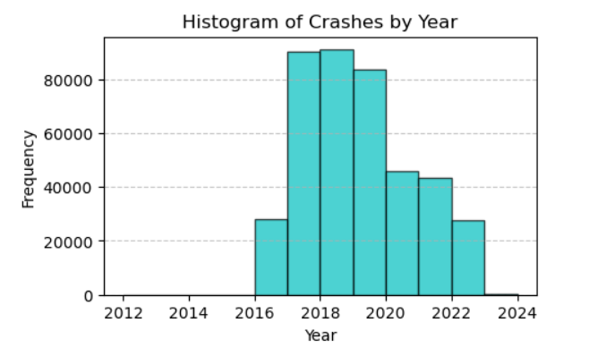

Slide 6
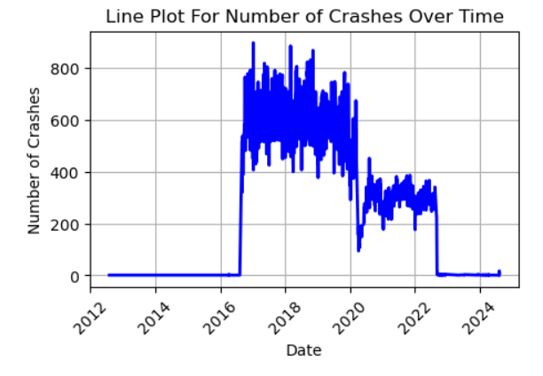
Time-Based Analysis:
Visuals:
Line Plot: Number of crashes over time.
Key Observations:
Seasonal or yearly trends in crash counts.
Any spikes or declines in certain years or months.

Slide 7
Geographic Analysis:
Visuals:
Boxplots for LATITUDE and LONGITUDE: Distribution of crash locations.
Key Observations:
Concentrations of crashes in certain areas (e.g., boroughs or neighborhoods).

Slide 8
Time vs. Month Heatmap
Visuals:
Heatmap : Crashes by year and month.
Key Observations:
Months/years with the highest number of crashes.
Temporal patterns in crash frequency.

Slide 9
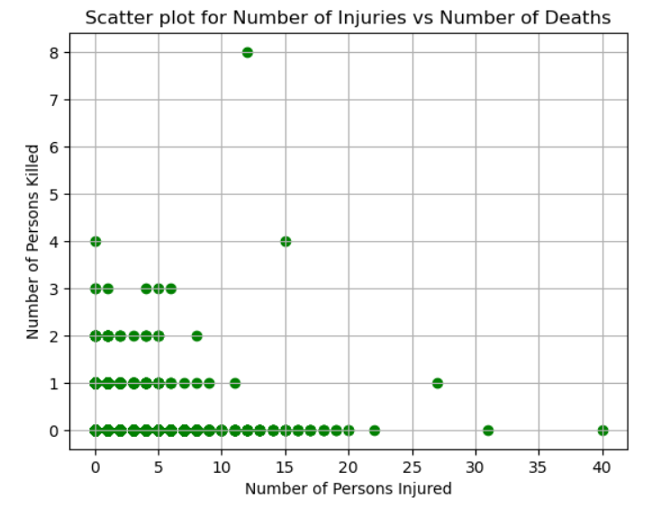
Injuries and Fatalities
Visualization:
Scatter Plot: Injuries vs. Fatalities.
Insights:
Correlation between injuries and fatalities.
Most crashes involve low or zero fatalities.

Slide 10
Conclusions and Recommendations
Key Findings : List the major trends, such as peak times, common causes, or high-risk locations.
Recommendations:
Improve road safety during peak times/dates.
Target education campaigns for common contributing factors.

Slide 11
“THANK YOU FOR YOUR ATTENTION!”

